Slide 1
Nitte Meenakshi institute of technology department of information science and engineering DATA INTEGRITY PROOFS IN CLOUD STORAGE
Akshata B Anjutagi Faculty name:
USN:1NT19IS401 Mrs. Navya C
Assistant professor

Slide 2

introduction
The process of storing data in the remotely located
cloud servers are said to be cloud storage.
In cloud data retrieved quickly, frequently and securely .
Cloud storage is visualized pools where data and
applications are stored which are hosted by the third party.
Some of the cloud storage benefits are reduce costs, provide more flexibility, reduce IT management of hardware and data, reduce management of web application through automated updates, and provide greater storage capacity.

Slide 3
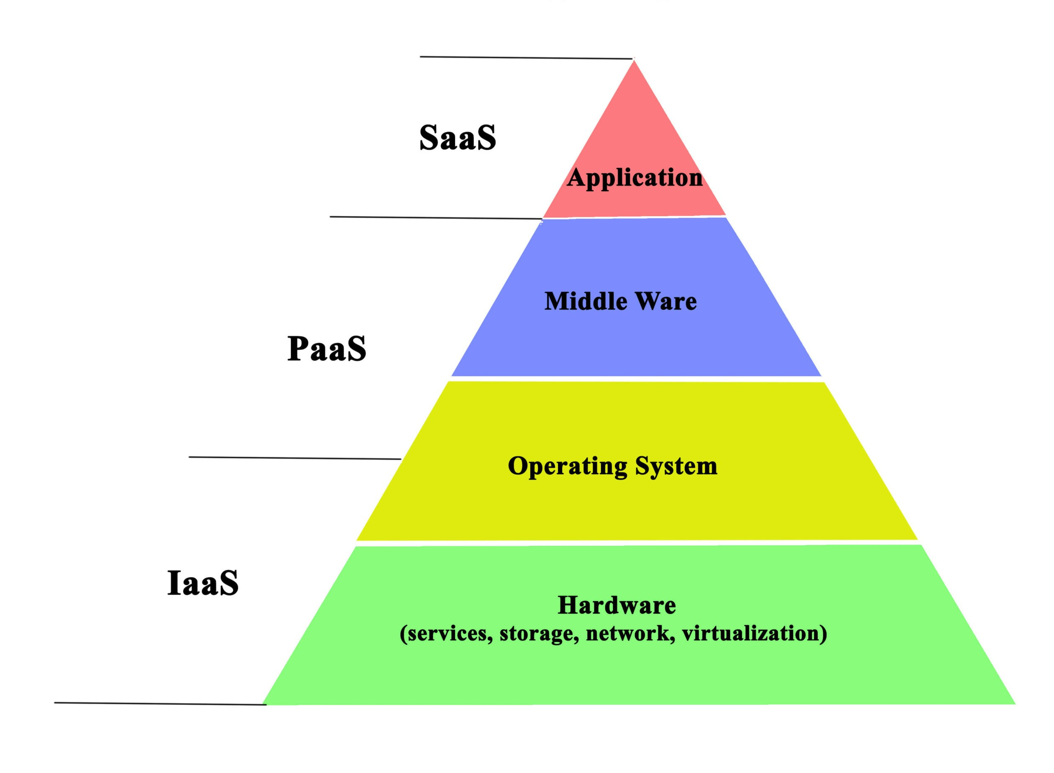
Cloud services

Slide 4
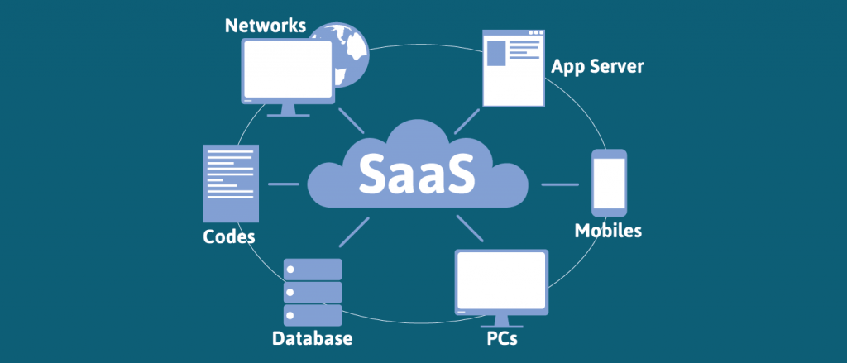
Saas (Software as a service)
Sometimes referred to as “ on-demand software”
is a software delivery model in which software and its
associated data are hosted centrally and are typically
accessed by users.
Saas also makes it easier to have the same software
on all your devices at once by accessing it on the cloud.
Benefits of saas are no local storage , smarter to rent,
on demand

Slide 5
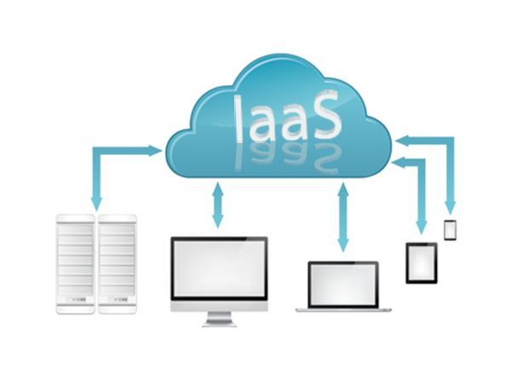
Iaas(infrastructure as a services)
An IAAS agreement, as the name states, deals primary
with computational infrastructure.
In IAAS agreement, the subscriber completely outsources
the storage and resources, such as hardware and software
that they need.
Benefits of IAAS are increased storage, reduce cost,
flexibility, increase mobility and high automated.

Slide 6
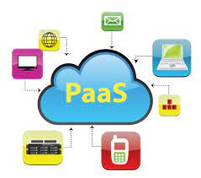
Paas(platform as a service)
it enables you to create web application quickly, without the cost and complexity of buying and managing the
underlying software or hardware.
A paas provider gives subscribers access to the components
that they require to develop and operate applications
over the internet.
Benefits of paas are no frequent updates, inexpensive.

Slide 7
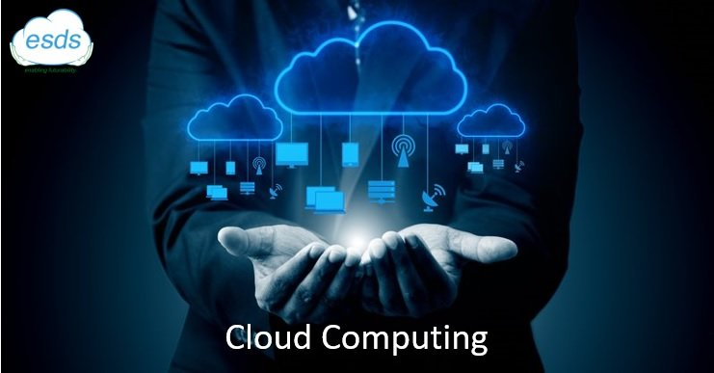
advantages
Avoiding local storage of data.
By reducing the costs of storage , maintenance and personal.
It reduces the chance of loosing data by hardware failures.
Not cheating the owner.
Apart from reduction in storage costs data to the cloud also helps in reducing the maintenance.

Slide 8
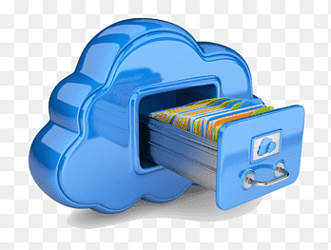
disadvantages
the main drawback of this scheme is high resources costs it require for the implementation.
Also computing hash value foe even a moderately large data files can be computationally burdensome for some clients(PDAs, mobile phones ect.
Data encryption is large so the disadvantages is small users with limited computationally power.

Slide 9
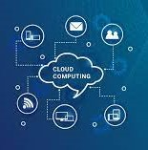
conclusion
Facilitate the client for getting a proof of integrity.
Advantages to thin client like PDAs, mobiles, laptops.
Network bandwidth is minimized as the size of proofs comparatively less.

Slide 10
thankyou

